Slide 1

MBZ Conference
March 29, 2010
Mastering a Long Distance Relationship
Hosted by Master Void & esclave

Slide 2



Mastering A Long Distance Relationship
Master Void
  15+ years in Lifestyle.
  Past local leader.
  Many Long Distance relationships
MV’s esclave
  4+ years in Lifestyle
  Second Long Distance lifestyle relationship

Slide 3
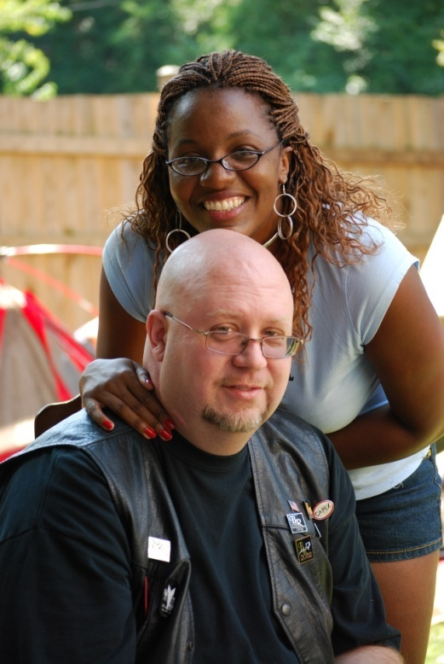
Mastering A Long Distance Relationship
Together for over 3 years
  He lives in NC
  She lives in NJ

Slide 4
Mastering A Long Distance Relationship
Esclave was collared in 2009
Married in November of 2010

Slide 5
Mastering A Long Distance Relationship
Key to success is
Communication

Slide 6
Mastering A Long Distance Relationship
Communication Goals:
  Rituals key
  Keep it Real
  Keep it Open
  Be Flexible
  Setting time aside for each other
  Be consistent
  Set Goals

Slide 7
Rituals
Being together ritual
  Change of mindset
Ending ritual
  Should include no hard play (minimize subdrop)
  Plan next visit together
Home Ritual (for when apart)
  Meditation
  Mantra (nightly)
  Email (daily)

Slide 8
Communication Tools
In the past, communication over long distances was expensive and often technically challenging.
No longer the case now.
We will share these tools with you now.

Slide 9

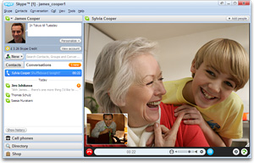
Communication Tools

Slide 10
Communication Tools
Cell Phone
  Helps to be on the same network
  iPhone/Android a major Plus
  SMS nice for sending short messages throughout the day
    Incorporated into our rituals
Google Voice
  Similar features but free

Slide 11

Communication Tools
E-mail
  It’s all about communications
  I require a daily email from esclave
  Journaling
I recommend

Slide 12

Communication Tools
  Allows online collaboration over Household documents.
  Share assignments.
  Share budgets.
  Enhance Planning
Other options: Zoho Office, Private Blog, 37signals.com, Wiki.

Slide 13

Communication Tools
  Required to keep Calendar up to date
  Can be shared
  Works well with iPhone or other Smart Phone
  Will send SMS or email reminders for appointments
  Helps with accountability

Slide 14
Other Relationships
Playing with Others
  Clear protocols
    What’s expected
    What’s permissible
    What’s not allowed
  Clear communications
  Self restraint
  Honesty
  Respect

Slide 15
Other Relationships
Poly Relationships
  Respect
  Master sets the tone
  Communication by all parties despite structure
    V, W, O
  Honesty

Slide 16
Other Relationships
Family
  Children
  Parents
  Siblings

Slide 17
Mastering A Long Distance Relationship
Concluding Remarks and Questions.

Slide 18

Copyright info
Image Bondage #2 © 2008 by Latente. Used by Creative Commons license. Some rights reserved.
Text of document © Master Void (MasterVoid@houseofvoid.com, Licensed under a Creative Commons License. Some rights reserved.
Attribution-ShareAlike 3.0 Unported (CC BY-SA 3.0)

